Slide 1
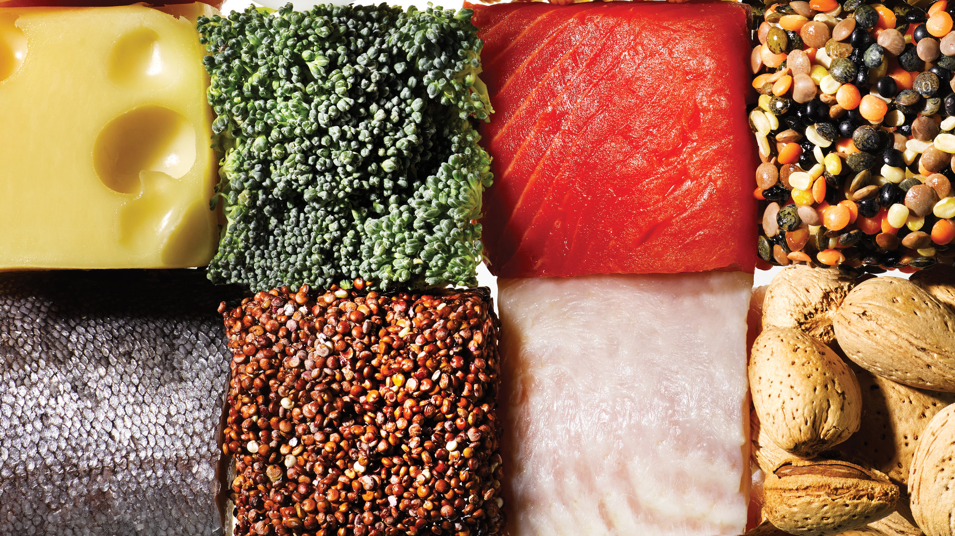
Tailored Nutrition
Sanjeev Sharma, Andrew Glyadchenko, Leon Campbell, Alvin Lam
Advnc apl:cpstne maj CSCI 49900
5-10-18

Slide 2
OUR INITIAL
VISION/GOAL
T
N
A Cross Platform Nutritional App That:
Allows for quick and easy logging of food.
Guides users by focusing on their proteins, fats, and carbohydrates, not just calories.
Finds the best nutritional plan to help the user achieve their fitness goal.

Slide 3







Our Story
A
B
C
D
E
Learn / Design
Welcome & Sign In/Sign up
User Profile
NutritionX API
Logging Foods
React Native basics.
Architecture, Wireframing
Various flows
Nutritional API research
Styling of all three screens.
User table creation with various bits of data received on sign up.
User authentication on sign in.
Styling of user profile.
Implementation of tab view to show search tab and log tab.
Calculate and display user nutritional limits.
Figuring out how to query the API for retrieval of macros and calories.
Implementation of barcode scanner.
Storing user food searches into user log table.
Subtracting logged macros from recommended.

Slide 4
What We Learned
Team based development using Github:
Learned about version control.
Learned about organizing, updating and assigning work.
Cross platform mobile development, specifically a lot about React Native and Expo. We had 0 experience coming into it.
Working with APIs. NutritionX is central to Tailored Nutrition and learning how to take full advantage of it was a early challenge
Quickly and efficiently developing screens on the front end so other group members can implement back end.
Writing code that is easily understood by others. We had some issues with this in the beginning…

Slide 5
What Went Well
User Interface
Our group spent a great deal of time planning and implementing an attractive UI. We wanted our app to look minimalistic.
UX was very important. We wanted the app to flow logically, and allow for easy use. We think we were able to achieve this.
Signup and Login
Our app allows devices to have multiples account. Each one of these accounts are their own session.
User data entered during signup is fed into many different functions to calculate users macro and calorie limits.
User authentication works.
NutritionX implementation:
Our app is able to provide search results for over 800,000 different food.
User can either search for foods by name, or simply scan a bar code.

Slide 6
What Went Well
4. User Profile
Every user has their own custom profile. This profile displays their name, calorie and macro limits calculated just for them. Alongside these are users remaining macros and calories for the day.
Food search exists here. User has the choice of searching for branded or unbranded foods.
User logs are displayed here.
5. Food Logs
Every user has a food logs table on our database. This table keeps track of name, macros, calories, and time logged for each food logged.
The total logged macros and calories are subtracted from user limits to show remaining limits.
Communication – It actually happened
a. Issues were opened and closed constantly. Retros were posted every week to make sure our sprints were met.
b. The team slack caused many panic attacks.

Slide 7

What Didn’t Go Well
A Series Of Unfortunate Events
We seriously bit off more than we could chew
Mobile development skills? Android. Database skill? Barely. UI skills? Not even. Make a new myfitnesspal + include a bunch of diets we can switch users in and out of in 6 weeks? YASS.
Initial time management – In the pursuit of perfection, we lost our way.
We initially focused too heavily on making things pretty. This included things like making custom buttons (I wish I was joking about this)
This went on until we realized there were 2.5 weeks left until presentation.
Distribution of work across sprints
Our initial sprint only consisted of signin/signup.
Our last sprint consisted of everything else. We simply spent too much time on our first sprint shining a turd as Jesse put it for us. (Shout outs to Jesse, thanks.)
Switching of diets
We designed for it and our source has all the functions to calculate new macros for the various diets.
Between losing time in the beginning and having trouble with NutritionX, we were unable to both implement and log food for long enough to show a switch during our demonstration.

Slide 8
TailoredNutrition();

Slide 9
Possible Improvements
Put the database online so users can login from different devices.
This would open up serious design choices about user security.
Fully implement the diet switching portion of the project.
Pull step count data from Google Fit/Apple Health API to remove the choice of activity level from the user.
Allow users to share logs and their fitness achievements.

Slide 10
To Summarize
We started off not knowing how to implement most of Tailored Nutrition. We were slow to learn as there was a lot to take in about API use, databases, and React Native.
Early on we spent a large deal of time stylizing pages for our app.
We learned a lot about Realm. Spent time trying to implement Realm but realized we had issues and made the decision to switch to SQLite for our database.
We learned about the USDA nutrition API, but quickly realized it was not full featured enough for our use case. We decided to go with NutritionX.
With these decisions, we began implementation of our backend.
Now, we have a working app that essentially does the same things you could do with myfitnesspal. Except Tailored Nutrition is made by Hunter students so it is inherently cooler.

Slide 11
return 0;

